Slide 1

SheSafe: Smartwatch for Women's Safety
SheSafe is an AI-powered safety smartwatch designed to provide real-time protection, threat detection, and emergency response for women.

Slide 2
COMPONENTS
The Problem
The Solution
Women face increasing safety risks in public spaces, with harassment, violence, and unsafe transportation posing significant concerns.
SheSafe provides a smart, automatic, and user-friendly solution that prioritizes women's safety.

Slide 3
SheSafe Technology
Sensors & Microcontrollers
Software & AI
SheSafe utilizes a combination of sensors, including a heart rate sensor, accelerometer, gyroscope, GPS, microphone, and vibration motor.
The smartwatch runs on software that processes gesture inputs, heart rate spikes, and noise detection in real time.

Slide 4

SheSafe Features
1
Emergency Detection & SOS Alert
2
Hand Gesture Recognition
Detects sudden heart rate spikes and forceful hand presses, sending automated SOS alerts to emergency contacts.
Users can activate/deactivate emergency alerts with a wrist movement (e.g., shaking), preventing false alarms.
3
Ride Safety & Route Tracking
4
Noise Detection & Audio Recording
Monitors ride deviations and alerts emergency contacts if the route changes unexpectedly, storing cab details securely.
Detects sharp loud sounds (e.g., screams, crashes) and automatically records audio, storing data for later review.

Slide 5
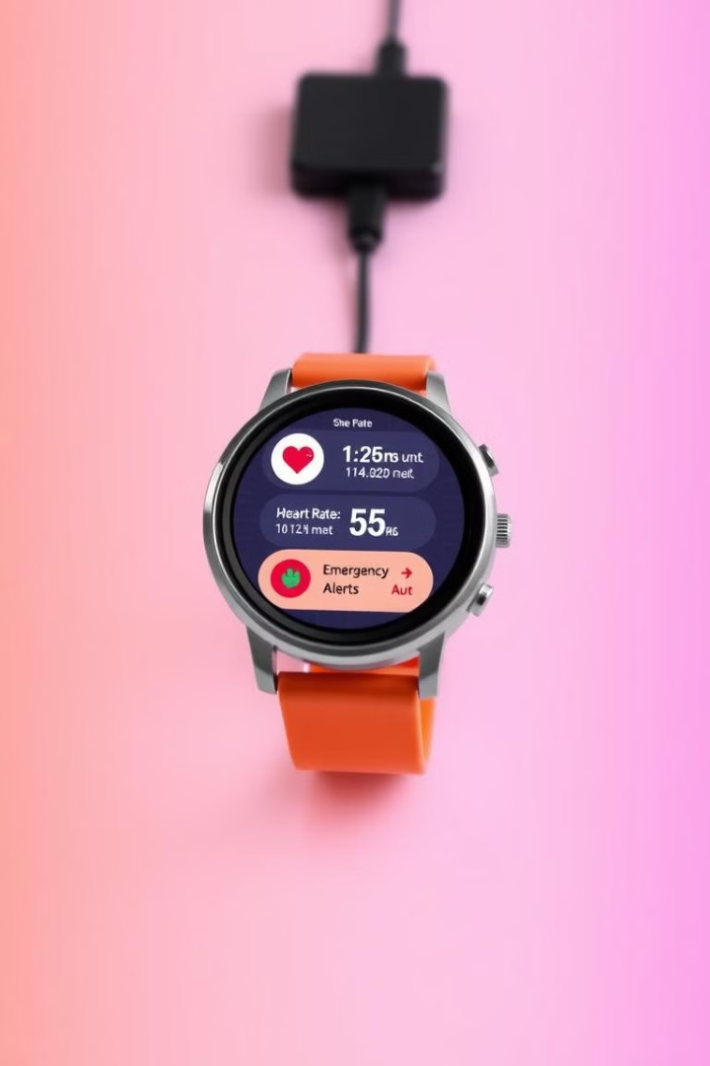
SheSafe Development Roadmap
1
Prototype Development
Our next goal is to design a full circuit diagram and create a working prototype that can simulate real-life distress situations.
2
Software Implementation
We aim to develop the software that processes gesture inputs, heart rate spikes, and noise detection in real time.
3
Advanced AI & Machine Learning
Future improvements will include AI-based threat detection, voice command activation, and predictive analytics.
4
Mobile App Integration
Users will be able to sync the watch with a mobile app for customizable safety settings, real-time tracking, and cloud data storage.

Slide 6

SheSafe Impact
Proactive Safety
Hands-Free Emergency Activation
SheSafe detects threats before escalation, providing a proactive approach to safety.
Gesture-based controls ensure easy activation of emergency features, even in stressful situations.
Real-Time Tracking
AI-Driven Detection
SheSafe keeps loved ones informed about the user's location and safety status.
SheSafe's AI algorithms reduce false alarms and improve the reliability of safety features.

Slide 7
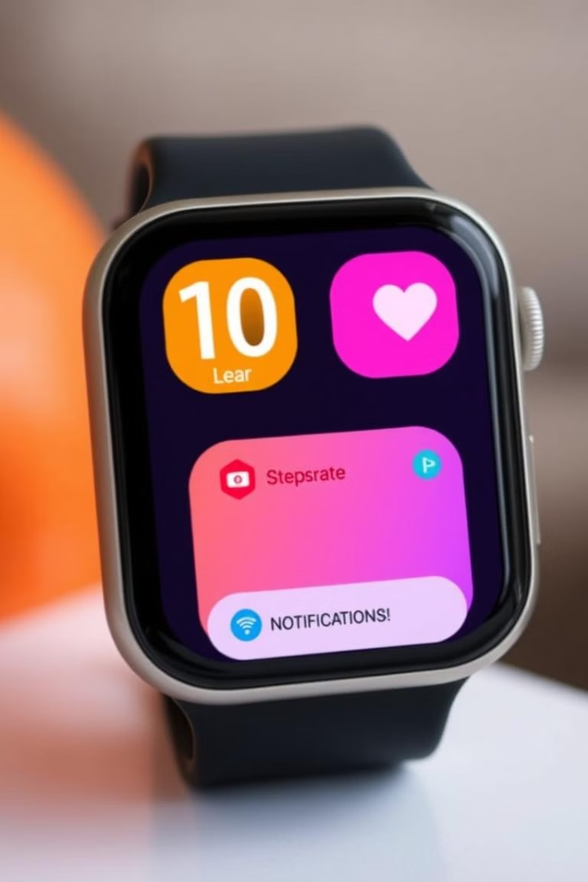
SheSafe: A User-Friendly Solution
SheSafe is designed for ease of use, even in stressful situations. Its user-friendly interface makes it accessible to all women, regardless of their technical expertise.

Slide 8

SheSafe: Empowering Women
SheSafe empowers women to take control of their safety and feel confident in any situation. It provides peace of mind and the assurance that help is always within reach.

Slide 9
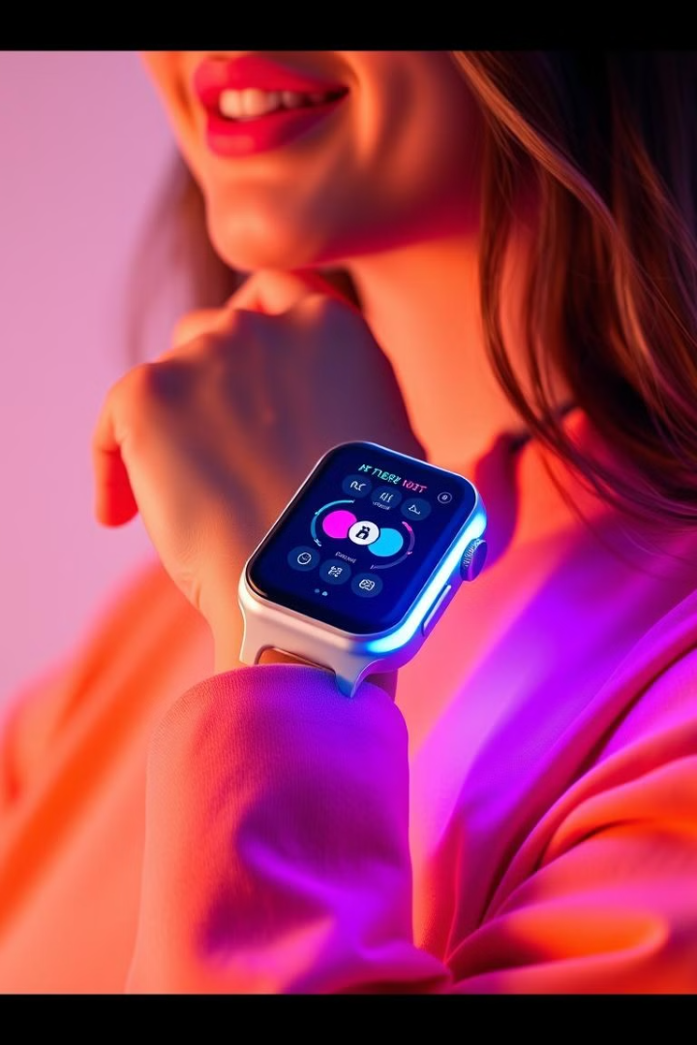
SheSafe: A Vision for the Future
SheSafe is constantly evolving, with future improvements including voice command activation, predictive analytics, and even more advanced AI-driven safety features.

Slide 10

SheSafe: A Call to Action
Join us in making SheSafe a reality. Together, we can create a safer world for women.

